Slide 1
WAPA IV – OPEN ACCESS
Nick Ehrke, Sales Director Southern Africa

Slide 2
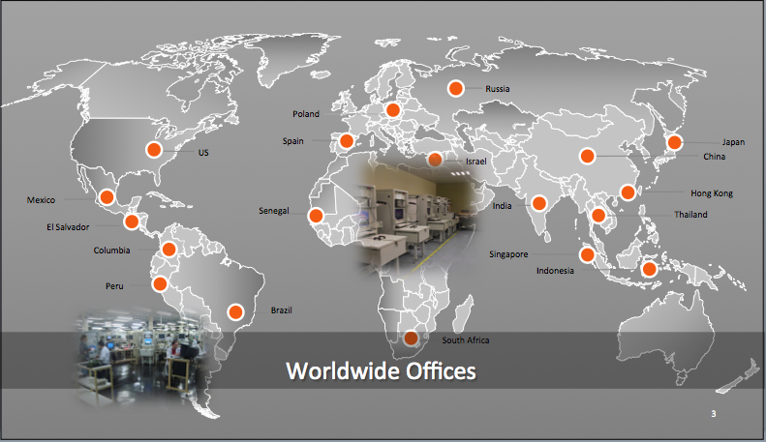
Leading provider of broadband wireless solutions
Established in 1997, Part of RAD Group
18 Regional offices worldwide
Deployments in over 150 countries
Employees by Department

Slide 3
Nationwide Open Access Wireless Network

Slide 4
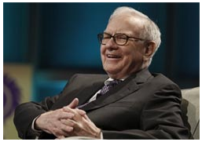
Open Access - Infrastructure as a Toll Bridge
Buffet was sued for Antitrust over his newspaper “The Evening News” that according to the Carrier–Express Newspaper, due to tactics, amounted to an illegal monopoly and trying to close down the newspaper.
Buffet was asked in the witness stand by Frederick Furth (Carrier-Express lawyer)
if Buffet had indeed said
“Owning a monopoly or market-dominant newspaper is like owning an unregulated toll-bridge”
“Why”
“Because you have laid out the capital costs. You build in old dollars, and when there is inflation, you don’t have to keep replacing it – a bridge you build only once.” ”
“Page 397
The Snowball: Warren Buffett and the Business of Life By Alice Schroede
Published by Bloomsbury, 2008”
Notes:
It is a great idea, and it would be a fantastic business to build a Wireless Open Access highway network, that everybody rides on. The reality in South Africa is that there is a company who has tried to do this, and is still working on their plan to build a Open Access Wireless Network.
They have gone to market to raise R250 million.
They have Microwave Spectrum already allocated to them, and they are looking to build a hybrid network using both RADWIN in license exempt band as well as LMDS with their spectrum…
I have first hand knowledge that their plan has already cost them business, that at least one large operator in SA has seen their plan as a direct threat and pulled out of doing business with them…
So we need to understand that there are already companies in SA who have an enormous investment in their network and will fight to keep both their investments, competitive advantage from their network s well as their revenue streams safe…. They are committed to staying profitable and relevant in the market place.

Slide 5
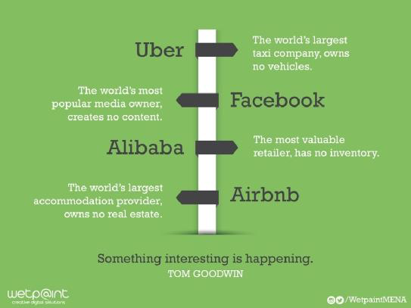
Peer to Peer (P2P) Changing the Operator Game
Notes:
In 2012, two of Alibaba’s portals handled 1.1 trillion yuan ($170 billion) in sales.
At closing time, on the date of its initial public offering (IPO), 19 September 2014, Alibaba's market value was measured as US$231 billion
Commercial benefit across the board – creates risk and opportunity

Slide 6
Peer to Peer (P2P) Changing the Operator Game
“In 2012, the World Bank calculated that a 10% increase in fixed broadband penetration in developing countries would result in a 1.35% increase in GDP growth. A more recent study found that doubling mobile data usage leads to a 0.5% increase in GDP growth.”
By Mmusi Maimane “in The Daily Maverick - Every cent invested in ICT will pay off in growth and jobs”
Consider that with SA Connect, South Africa NDP targets universal average download speed of 100Mbps by 2030, and average user experience of 5Mbps to be reached by 2016 and available to 50% of the population (90% by 2020).
15/09/22

Slide 7
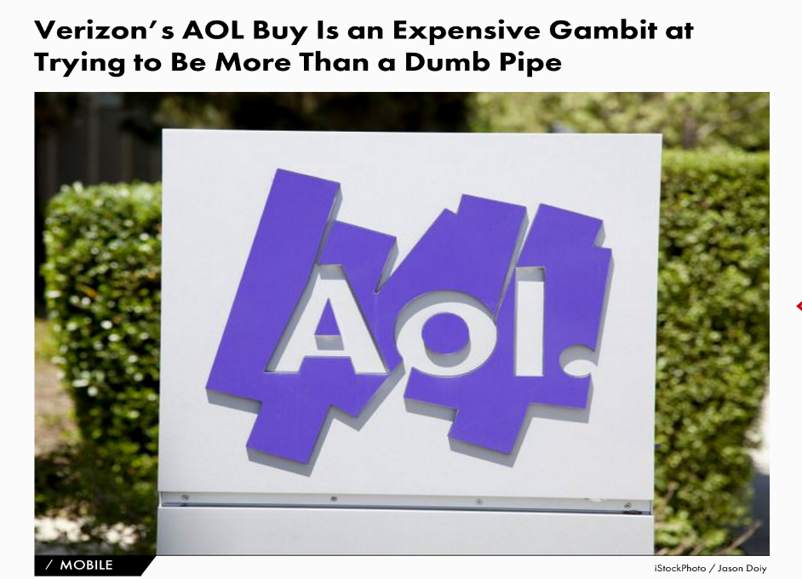
Shifting Priorities for MNO’s – Bridge is not enough
Verizon purchases AOL for $4.4bn
“Both Verizon and AOL have talked up how their union will swell the mobile video and TV market, signaling how ad tech - not content - will be at the fore of the merged media offering for advertisers. Verizon sees the transformation of smartphones into a primary channel for TV content.
The telecoms firm said the acquisition would “further drive its over the top video strategy, showing that it wants to make a profit from content instead of just serving it.”*
“Traditional mobile communication is being disrupted - voice, SMS and MMS are all on the chopping block as far as consumers are concerned. And where does this leave operators? Increasingly looped out of their customers’ experience and with the technology they’ve spent billions of dollars and years investing in now leaning towards irrelevance.
The loss of those services by the operators to OTT apps translates into a loss in revenue of nearly $479 billion from 2013 to 2020, with $71 billion of that loss realized in 2013 alone, according to Ovum…”**
*http://www.thedrum.com/news/2015/05/13/what-verizon-s-44bn-aol-purchase-means-media-focused-advertisers
**Making Sense of the Meteoric Rise of OTT Apps Posted by Tristan Barnum on October 29 2013

Slide 8
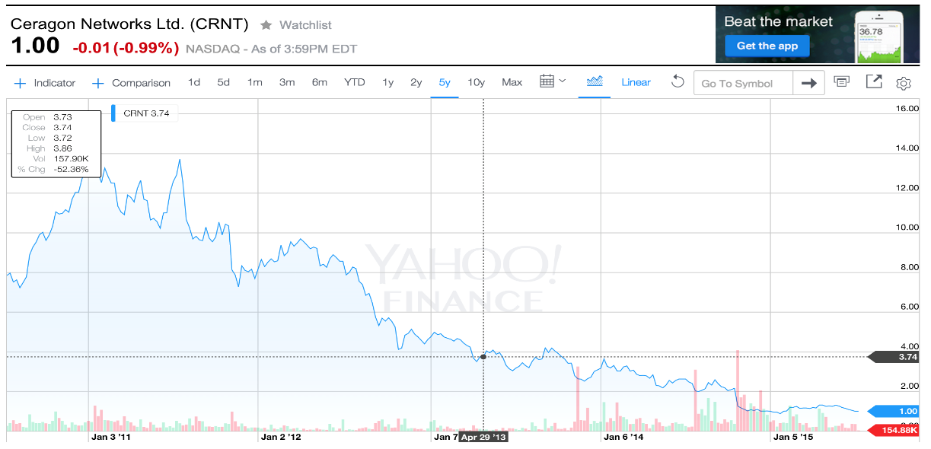
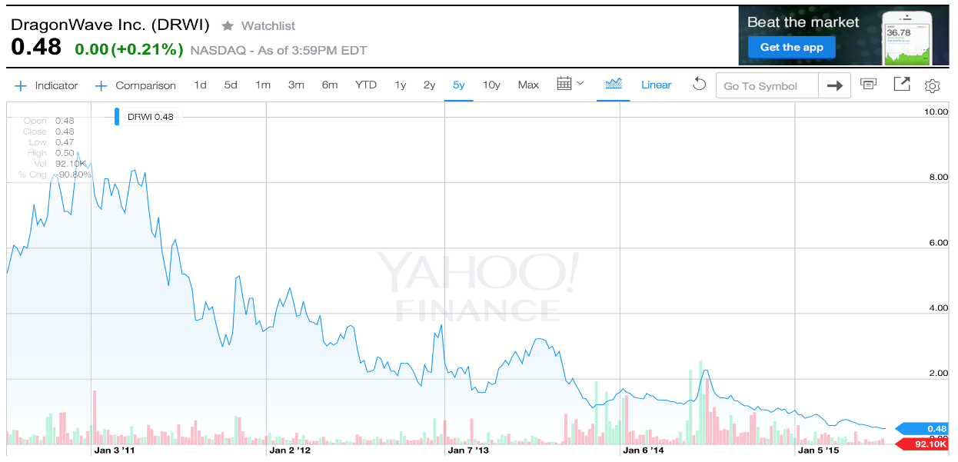
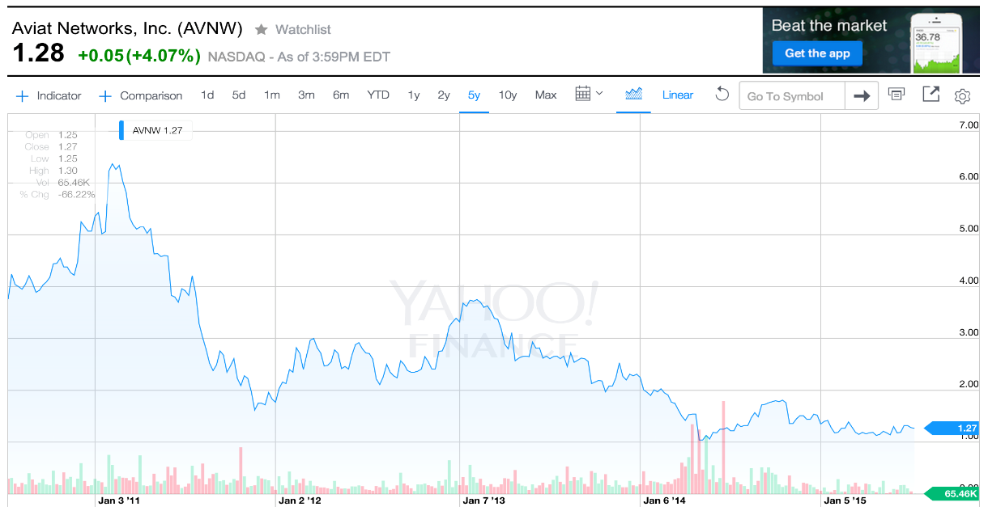
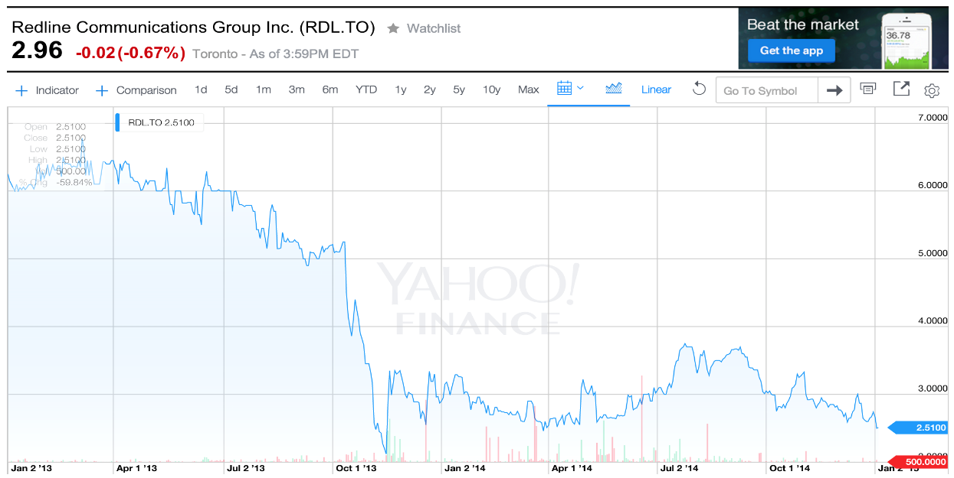
The Microwave Vendor Challenge Share Price over the last 3-5 years
Notes:
Fibre & Bundling
I am sure you can see the trend – why the trend? What is happening.
We can say that Fibre is replacing the traditional microwave business model for large capacity backhaul.
PtP is not an Access Technology – and right now it’s all about access.
But we are also seeing that traditional microwave vendors aren’t able to bundle, and in fact Microwave has become commoditized - We are seeing the large Telecoms manufacturers are bundling Microwave when operators purchase their core network
We saw this in Mozambique recently, a vendor threw in older microwave technology, why? Because Microwave has become a dumb pipe.
I mean really, who cares if one technology is 10% less efficient than another --- if it is free?
So this is the take away, something interesting is happening…

Slide 9
Can wireless networks be Open Access?
Is there a way to overcome;
Regulatory obstacles
Commercial obstacles
Operational issues
Is there a way to adopt a wholesale-only open-access network model in SA, with the separation between the Network Operator and Services Providers?
Open Access would need to be a compilation of Layer 2 technologies to reach SA / Africa.
Wi-Fi
Mobile (3G, WiMAX and LTE)
Wireless PtP & PtMP
Satellite
Fixed Line (xDSL)
Fibre

Slide 10
Open Access - The Spectrum / Technology Reality
Spectrum is a scares, limited, finite resource
National License Spectrum is expensive
Spectrum is not necessarily a competitive advantage!
800MHz – 1800MHz
Great outdoor overage – best fit for voice services
Lower data capacity and best effort internet service
2.1 / 2.5 – 2,6GHz
Suitable for LTE – (Better indoor penetration and large ecosystem)
LTE does not address Enterprise requirements for dedicated service – no layer 2 service
LTE is a consumer/retail play – typically lower cost
3.5 / 3.6GHz
Not suitable for LTE - (poor indoor penetration and no ecosystem)
WiMAX is obsolete - doesn’t meet capacity demanded by enterprise for >10Mbps service (Max 40Mbps per Base Station)
14MHz / 28MHz, even 56MHz doesn’t deliver enough capacity for national network
MNO’s, Tier 1 ISP’s are targeting xDSL replacement – enterprise customers where the $$$ are. Not residential.
LMDS
26GHz and 28GHz equipment is still too expensive to be truly viable for Open Access network… Right now, it is costing itself out of the market.
Consider Spectrum License Costs and then include $2,000 - $3,000 per CPE
Notes:
1) MNO’s and ISP’s alike are trying to reach customers first but both face the same challenges
2) ‘High touch’ networks lead to increased costs.

Slide 11
The Spectrum Challenge
In SA, over 400 Independent WISP are working in 460MHz of bandwidth in Sub6GHz for Access
Notes:
MNO’s are turning to Unlicensed Spectrum as one of the key solutions for their growing network demands
Not enough Fibre, in the wrong place and the cost is prohibitive
Microwave is too expensive, not enough of the right spectrum, NLOS issues
Copper is no longer an option

Slide 12
The Spectrum Challenge
Due to demand for cheaper broadband and greater capacity, MNO’s are adopting ISM Band for;
Last mile access to compete with fixed line services (BWA)
LTE Advanced
Back-up to FttX
Small Cell Backhaul in NLOS environments
80MHz in 2.4GHz
380MHz in 5.xGHZ
200MHz in 17GHZ (PtP)

Slide 13
Wireless Open Access
Consideration must be given to;
The allocation and use of finite or scarce spectrum resources exerts a critical influence on the broadband landscape – a “Use it or lose it” approach by ICASA needs to be enforced
The regulator needs to open up more spectrum for Licensed-Exempt use…
Interference management
Eliminate interference issues : critical for open network
(RADWIN PoV – this needs to be done by the manufacturer – cannot fix interference by regulation alone or simply more spectrum due to rising demand!)
Service level
Assure support for SLA
Eliminate dependencies between different service providers
Over commitment of a service provider will not affect users from other service provider
Total deployment cost
Non – Discrimination of customers

Slide 14
Thank You!

