Slide 1
Why do we have EIRP Limits?
William Stucke
FWTF V
12th May 2016
Century City, Cape Town

Slide 2
What is EIRP?
Effective (or Equivalent) Isotropic Radiated Power
Conceptually, consider an antenna as a point source

Slide 3
Calculating EIRP
Simple equation:
EIRP = Transmitted Power – Cable Losses + Antenna Gain
Measured in dBm or dBW
1 dBW = 30 dBm
Antenna gain measured in dBi

Slide 4
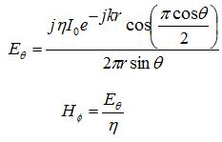
Dipole Antenna
Z_{in} = 73 + j42.5 Ω
At Length = 0.48 λ, Z_{in} = 70 Ω

Slide 5
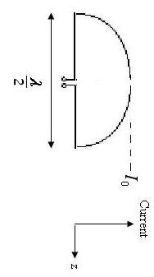
Antenna Gain
Antenna gain is calculated as compared to a theoretical spherical radiation pattern
A simple dipole antenna flattens the sphere into a doughnut and may give a gain of up to about 8 dBi

Slide 6
Dipole antenna

Slide 7
Dipole antenna

Slide 8
Yagi-Uda Antenna
Invented in 1928, but only translated into English much later
Gives a gain of up to 20 dBi
Can receive weaker signals
Simple construction – made of metal rods
Highly directional
Reduces sensitivity to interference

Slide 9
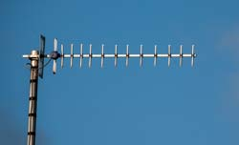
Yagi-Uda Antenna

Slide 10
Yagi-Uda Antenna
Reflectors - longer than driven element = Inductive
Directors - shorter than driven element = Capacitive

Slide 11
Yagi-Uda Antenna

Slide 12
Idealised Coverage
Omni Antenna Sector Antenna

Slide 13
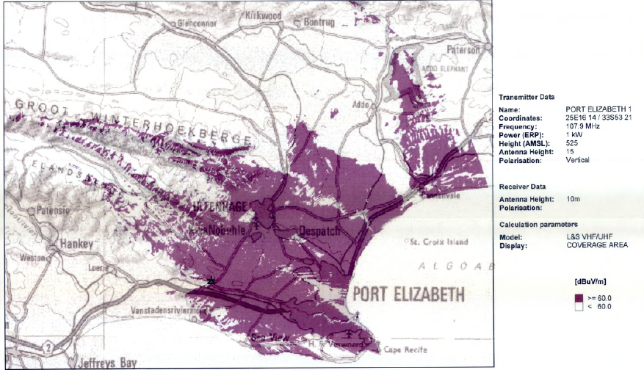
Real Coverage Example

Slide 14
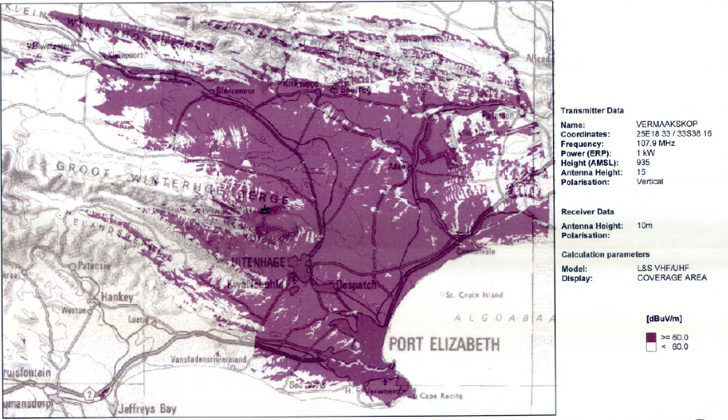
Real Coverage Example 2

Slide 15
Why Specify EIRP Limits?
A simple and robust method of limiting transmitted power
Important in terms of reducing interference, especially for PtMP, as it reduces the effective range
Easy to set, easy to define, easy to measure
Not always appropriate for PtP uses

Slide 16
Licence-Exempt Bands
Band | Type | Limit | Comment
2400 – 2483.5 MHz | WLAN | 100 mW | 20 dBm EIRP
5470 – 5725 MHz | WAS & RLAN | 1 W | 30 dBm EIRP PtMP
5725 – 5850 MHz | WAS & RLAN | 4 W EIRP 1 W Tx power | Tx output spectral density < 8 dBm in any 3 kHz band.
5725 – 5850 MHz | BFWA | 200 W EIRP 1 W Tx power | Tx output spectral density < 8 dBm in any 3 kHz band.
17.1 – 17.3 GHz | HiperLAN | 100 mW EIRP

Slide 17
Licence-Exempt Bands
Band | Type | Limit | Comment
24.00 – 24.25 GHz | SRD |  | Not approved by ICASA for PtP or PtMP
57.00 – 64 GHz | PtP | 55 dBm EIRP | ICASA revising – V Band
57.00 – 66 GHz | MGWS | 40 dBm | ICASA revising
71-76 GHz and 81-86 GHz |  |  | E Band - PtP

Slide 18
A little History
FCC use “Part 15” to regulate these bands
Recently reduced EIRP limits in the 5 GHz band
ICASA revising V & E bands

Slide 19
High Gain Antenna PtP Link
Red Antenna points beam at Blue antenna. Blue antenna points back. High gain means that: -
Better reception at a distance, without higher transmitted power
Good rejection of incident signals from other directions
Notes:
Curve represents a Dish antenna
Triangle represents the beam transmitted by the dish antenna
The two dishes are aimed accurately at each other. Red antenna may have as much as 30dB gain for the Blue antenna, compared to signals from other directions. Similarly for the Blue antenna selectively receiving the Red signal.

Slide 20
Many PtP Links
Notes:
Many PtP Links can exist in the same geographical area, even with exactly the same frequency. Provided these links either don’t cross at all, or cross at a sufficiently oblique angle, there is no problem. However, if two beams are very close to each other in both position and angle, there is a danger of interference between the two beams. This is highlighted by the grey oval.
The process of calculating if any interference is likely to occur between uses of a frequency is called “coordination”. It is computationally intensive, and takes some time to complete. With today’s equipment, you can expect to coordinate perhaps 200 uses in 24 hours of server time.

Slide 21
What do we need to change?
EIRP limitations on PtP links – to allow more directional antennas
Longer range
Better directionality
Better interference resistance
Less interference caused
Introduce dynamic spectrum assignment – White Spaces

