Slide 1
OPTICAL WIRELESS BROADBAND – CARRIER GRADE TECHNOLOGY WITHOUT THE LICENSING COST
www.redlinetechnologies.net

Slide 2
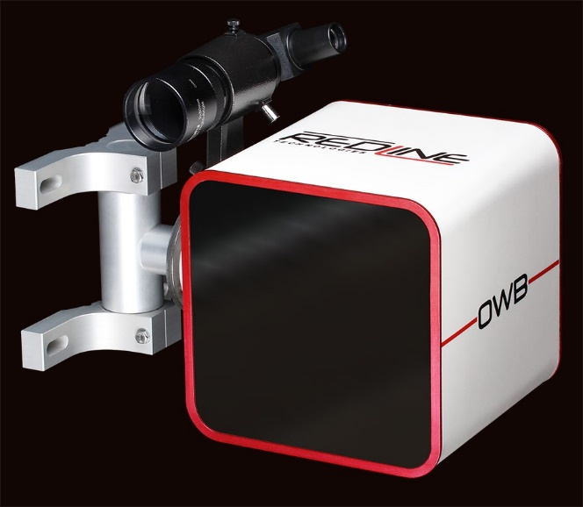
OPTICAL WIRELESS BROADBAND
Optical Wireless Broadband
Infrared Optical laser beams to transmit data
Frequency 3-4 THz
License exempt worldwide – Can be installed in a week
Provide robust links at 2km range and more in low rainfall areas
High data-rates of 1Gbps Full-Duplex (2Gbps) -> 2.5Gbps -> 10Gbps on its way
Availability in SA
99.98% to 99.999%
1550nm vs. 850nm
More than double the power is required because of
Quantum Efficiency (QE)
Atmospheric effects which limits transmission is the same
“Comparison of laser beam propagation at 785 nm and 1550 nm in fog and haze for optical wireless
Communications”
Isaac I. Kim, Bruce McArthur, and Eric Korevaar
www.redlinetechnologies.net

Slide 3
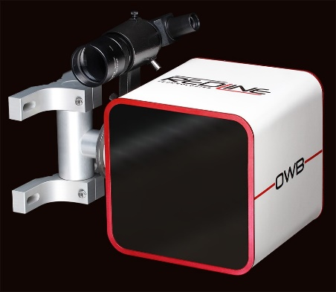
TECH TALK: FEATURES
OWB Features
OWB uses Multiple/large transmit apertures to overcome scintillation
Avalanche Photo Diode (APD) technology increases receiver sensitivity
Autonomous alignment – Increases link budget and availability
Ranges and data-rates are increasing with cost effective techniques
Managed via online cloud based server (RedView)
NanoWave G1000 – Lowest Cost, Smallest, lightest OWB system with Autonomous Alignment
Quick Specs
Weight: 5Kg
Dimensions: 350mm x 210mm x 210mm
2km for carrier grade availability in SA
Temperature: -20 to 60 Degrees
Blends into environment
www.redlinetechnologies.net

Slide 4
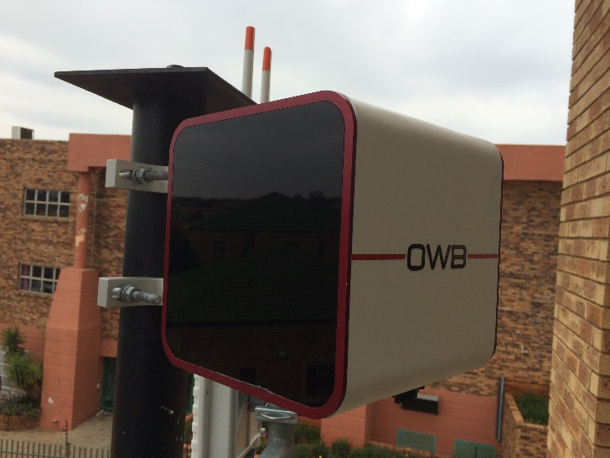
TECH TALK: AVAILABILITY
Availability Increases with Shorter Distance
500m
1500m
2000m
3000m
 | 99.999% | 99.98% | 99.9% | 99 %

Slide 5
HYBRID WIRELESS SOLUTION
mmWave The atmospheric limiting factor
Rain (“Estimation of Terrestrial Rain Attenuation of Microwave and
Millimeter Wave Signals in South-Africa Using ITU-R Model”,
P.A Owolawi, S.J Malinga, T.J.O Afullo)
Availability in SA
Max 99.9% (Rainy seasons tend to have a major impact on performance)
Hybrid
OWB and mmWave together can provide robust Gigabit links
www.redlinetechnologies.net

Slide 6
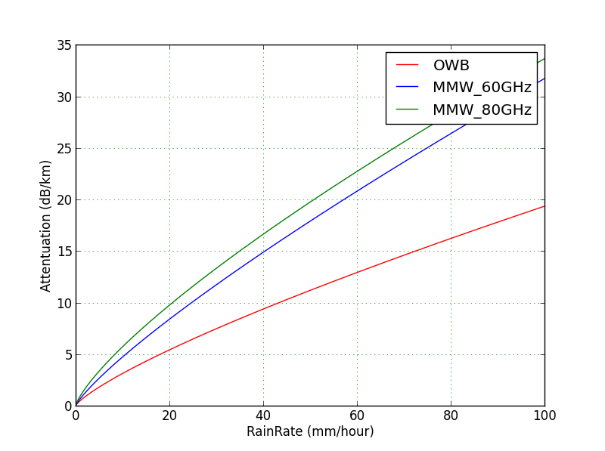
WIRELESS TRANSMISSION IN RAIN
www.redlinetechnologies.net

Slide 7
TECHNOLOGY COMPARISON
 | Data Rate | Product Cost | License Exempt | Deployment | Security | Interference Immunity | Link Availability | Form Factor | Range
OWB | 1000Mbps | $15K | YES | Days | Very High | Very High | 99.98% | Small | 1500 meter
70-80GHz | 1000Mbps | $30K | NO | Days | High | Medium | 99.9 % | Medium | 2500 meter
60GHz | 1000Mbps | $17K | NO | Days | High | Medium | 99.9 % | Medium | 800 meter
5.8Ghz | 500Mbps | $15K | YES | Days | Low | Low | 99.9% | Medium | 30km
11-38GHz | 622Mbps | $50K | NO | Days | Low | Low | 99.99% | Large | 30km
Fibre | > 1000Mbps | $50K | YES | Months | Very High | N/A | 99.999% | Large | N/A
www.redlinetechnologies.net

Slide 8
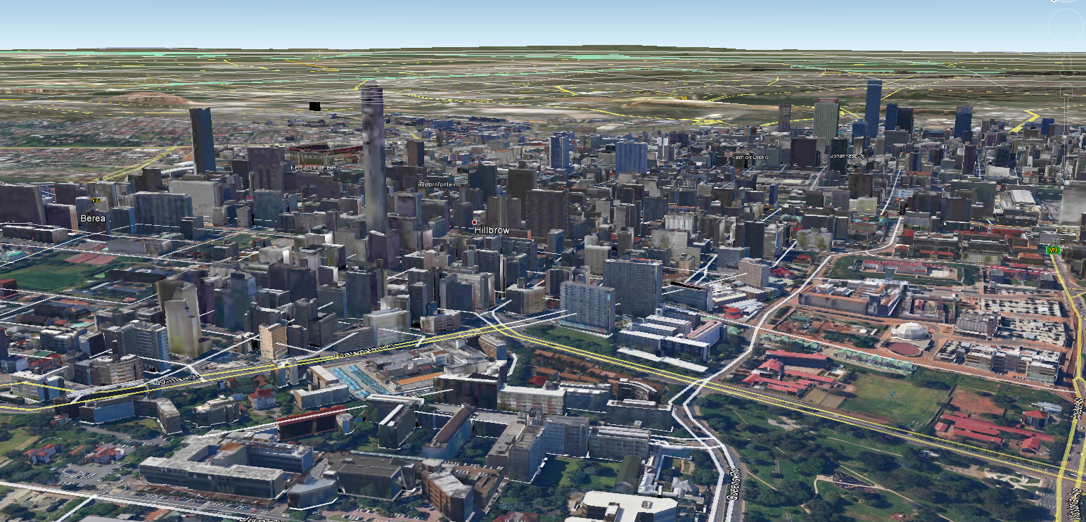
SOLUTIONS
RING NETWORK
CONFIGURATION
STAR NETWORK
CONFIGURATION
GIGABIT OWB: Ring – Star – Mesh
www.redlinetechnologies.net

Slide 9
WHO IS USING OWB?
35 African Countries
Enterprise market
Telco Markets
Universities/ Campus

Slide 10
CONCLUSSION
Optical Wireless Broadband
Can be a standalone installation
Spectrum license exempt
Quick to install
Low maintenance due to autonomous alignment
Markets
4G/LTE Backhauling
Enterprise connectivity
We foresee that OWB technology will dominate high capacity wireless network infrastructure with the adoption of LTE.
www.redlinetechnologies.net

Slide 11
OPTICAL WIRELESS BROADBAND – CARRIER GRADE TECHNOLOGY WITHOUT THE LICENSING COST
www.redlinetechnologies.net

